Slide 1
DS Project

Slide 2
TABLE OF CONTENTS
01
03
02
04
Technologies used
How we implement it
Who did what?
Lessons learned

Slide 3

Our Website
Our project is based on a movie review website that will allow the user to add his own opinion about a specific movie .

Slide 4

MongoDb MongoCompass
Technologies used
Java Lombok
Spring Initializr SpringBootr
React
For the database
For the backend
For the backend
For the frontend

Slide 5
Who did what?
backend
Georgio
El Khoury
Marie-Josee
Tannous
Toni
Tannous
frontend
database

Slide 6

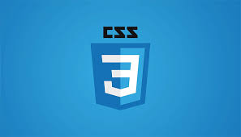
Technologies used for Frontend

Slide 7
NPM Packages used:
Axios:
HTTP requests from React client to API
Retrieve movie data from database through HTTP requests
Bootstrap
Layouts and styling within the React project
React Player
Integrates React player into React app
React Router DOM
Component routing
Material Ui
Implement a carousel

Slide 8
Components
Layout Component imports the Outlet component from the React Router DOM package.
House Component has a child component called Hero that implements the Carousel.
Header Component implements the navigation bar.
Trailer Component imports the React Player and implements the trailer of the movies.
Reviews Component has a child component called ReviewForms that contains a text area where the user can input text.

Slide 9
Java Classes
Variables: ID, release date, list of reviews.
Return the review to the database
Takes a request and send a response
MovieRepository,
ReviewRepository
Movie
MovieController
ReviewController
ReviewService
Uses a map<K,V>
Extends MongodbRepository

Slide 10

THANK YOU

